Slide 1
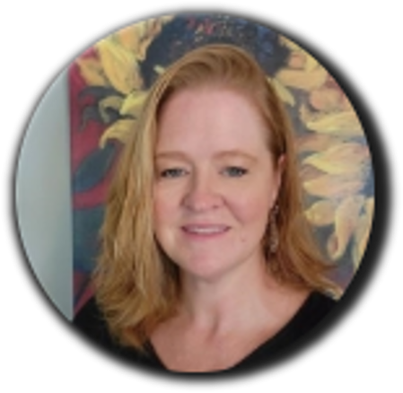
Welcome MAC Meeting
Debra Citta
Program Coordinator

Slide 3
SAFETY FIRST
Important Building Information

Slide 4
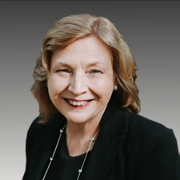
WELCOME
Marilyn Lineberger
Manager Corporate Communications

Slide 5
INTRODUCTIONS

Slide 6
EnergyUnited Foundation
Debra Citta
Program Coordinator

Slide 7
A Year In Review

Slide 8
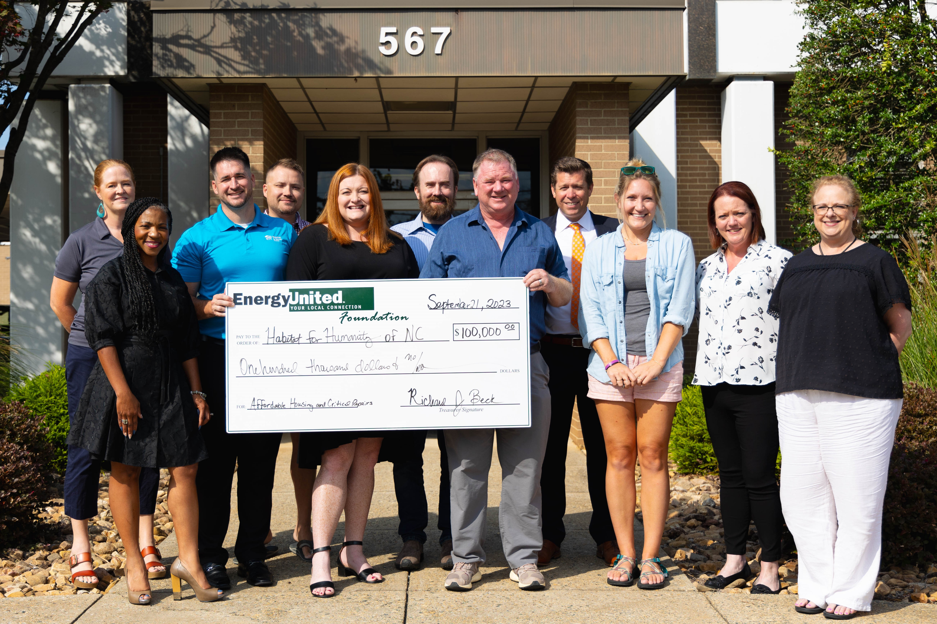
Historic $100K Donation to 16 Habitat for Humanity Affiliates
From Alexander Habitat for Humanity:
The EU Foundation Grant helped build a home for a single mother with one child. She was brought to the US at the age of 6 months (so she has only known life in the US). Her parents were deported when she was fifteen. She and her siblings were homeless for a time. Eventually a relative took her in and helped to stabilize her situation. She graduated High School on schedule and found herself a mother at 19. She enrolled herself in DACA and enrolled her child in Early Head Start so they could provide support to her on how to raise her child.
The DACA Agency saw her potential and decided to hire her as a part-time interpreter. Soon she was given additional responsibilities as a classroom teacher. Currently she has been promoted to a full-time in-home Parent Educator. She is working on a degree in Early Childhood Development and Certification as a Doula and Lactation Educator. Her resiliency has allowed her to use her early struggles and obstacles as an inspiration to help others, to give them the support they need.
She moved into her Habitat home in late January 2024.

Slide 9
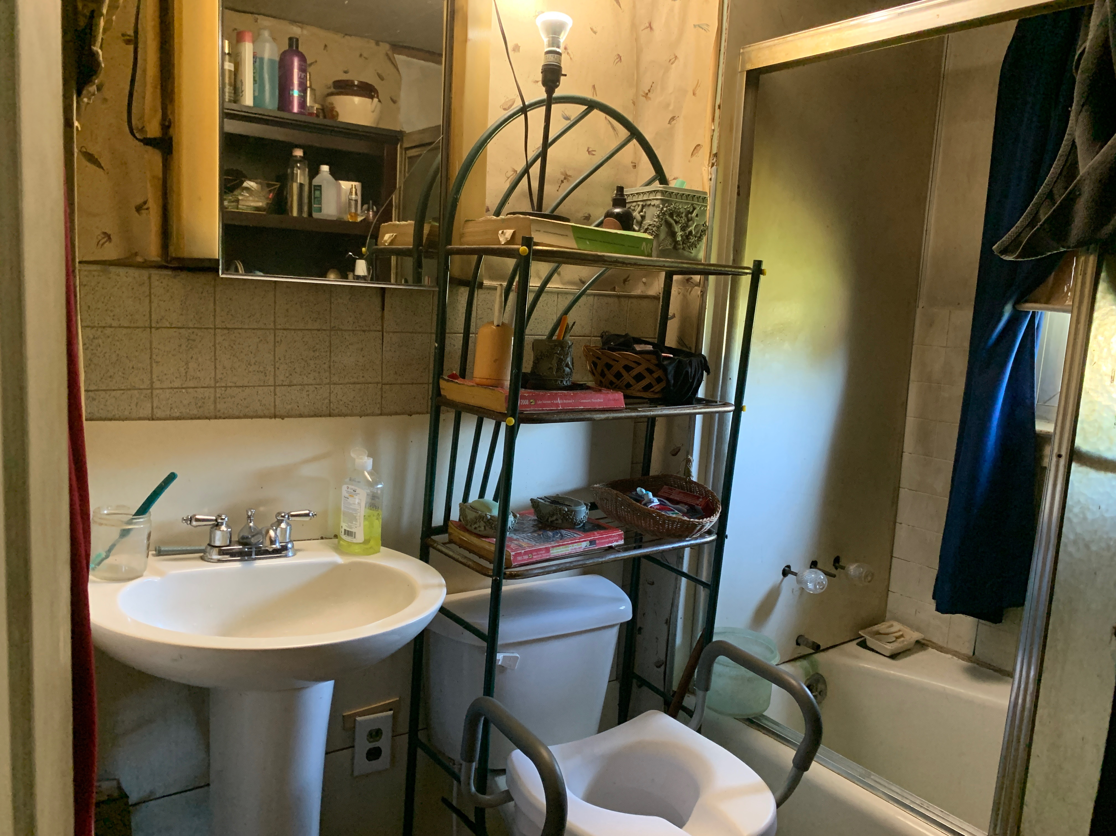
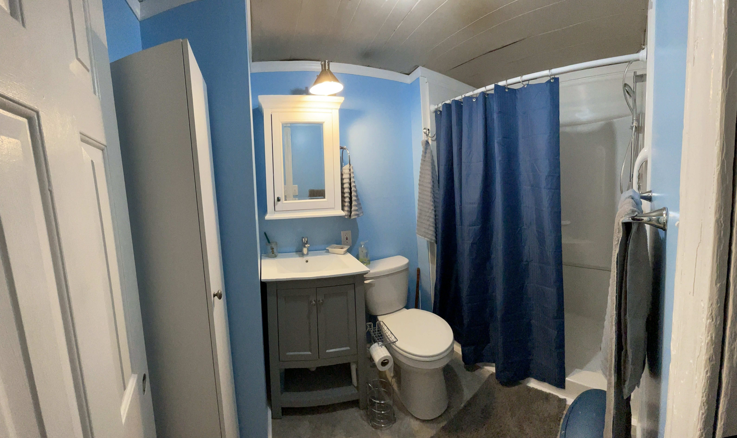
EU Foundation Donation Inspires Iredell Community to Assist Elderly Couple and Their Disabled Son
Before
EU Members Ethel and Richard Cowans’ bill was nearly triple the average, so they reached out to EU Billing and Metering Services. Ronnie Wooten, EnergyUnited’s Metering Services supervisor, found an issue with their home’s well. It wasn’t shutting off like it should and was using an extraordinary amount of energy. In addition, rusted pipes were producing poor water quality and the water heater was leaking so badly that the yard was soggy.
Ronnie helped the Cowans apply for funds with the EnergyUnited Foundation. They were approved for assistance with the new water lines, trenching, a new water heater, labor costs and connection to Iredell Water Corporation.
Parlier Plumbing who worked on this job saw the condition of the Cowans' bathroom and agreed to donate and install a toilet and shower. Another friend of Ronnie's donated a sink, vanity and showerhead. Labor was provided by the Wooten family, a Baptist Men's Group and other community members
Billing, Member Support, the EnergyUnited Foundation and community members all came together to make this happen. This is what connection looks like.
After

Slide 10
We are now recruiting for the 2023 Empowering the Future Scholarship program! EnergyUnited will be awarding two $5,000 college scholarships to high school ​seniors this April. ​ The deadline to apply is March 31​

Slide 11
We are now recruiting for our 2023 Sports Camp program! If you know a young boy or girl in the fifth or sixth grade who enjoys playing basketball, please encourage them to apply!​ ​ Deadline to apply is March 31​

Slide 12
SAVE THE DATES
NEXT MAC MEETING
Statesville – June 6, 2024
Lexington – June 13, 2024
Lake Norman – June 27, 2024

