Slide 1
WELCOME

Slide 2
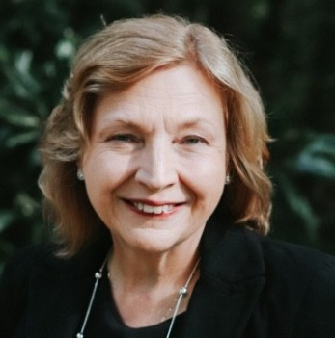
Welcome
Marilyn Lineberger
Manager Corporate Communication

Slide 4
Agenda
Welcome & Safety
Introductions
A Day in the Life of EnergyUnited's CEO
Rate Conversation
Energy Efficiency
SCAMs

Slide 5
SAFETY FIRST
Important Building Information

Slide 6
INTRODUCTIONS

Slide 7
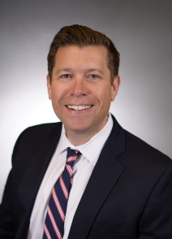
Day In the Life
Thomas Golden
CEO

Slide 8
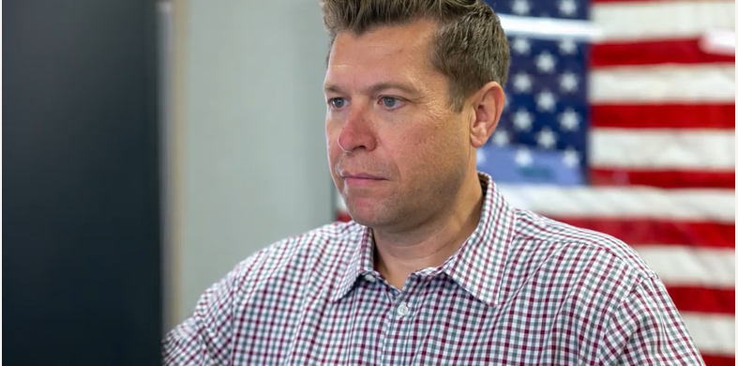
Day in the Life Slideshow
https://www.dropbox.com/scl/fi/g1bbrdt0x1qibr4dhnx21/CEO-Day-in-the-Life-Slideshow-4K.mov?rlkey=ar3mibfmqti72z1hgw9ouauol&e=1&st=kvpmeh65&dl=0

Slide 9
A Day in the Life of the CEO
Planning
Strategic and operational planning, membership meetings, legislation, service rules & regulations
Organization
Recruiting and hiring top talent and designing organization for efficiency
Operations
Day-to-day operations and activities for the cooperative as well as public and member relations
Financials
Rates, equipment, materials and supplies
Controls
Make sure the cooperative is run properly as it pertains to finances, checks and balances, operations, budgets and member care
Source: https://www.energyunited.com/wp-content/uploads/2024/03/Board-Policy-Manual.v2024.01.18.pdf

Slide 10
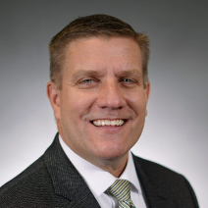
Rate Conversation
Brett Alkins
COO

Slide 11
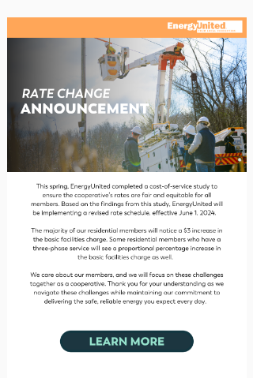
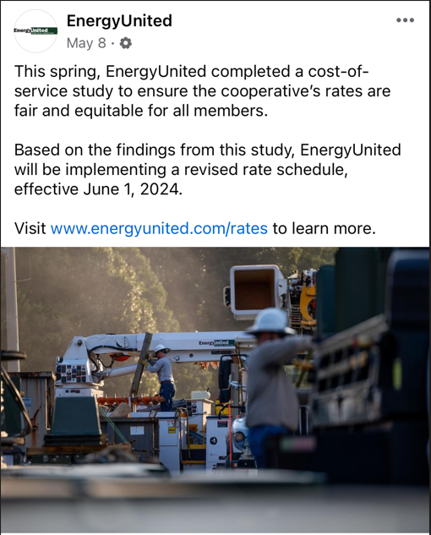
Rate Conversation
Rate Change Communications:
Did we communicate the rate change effectively?
How could we get better?
What would you like to hear more about?

Slide 12
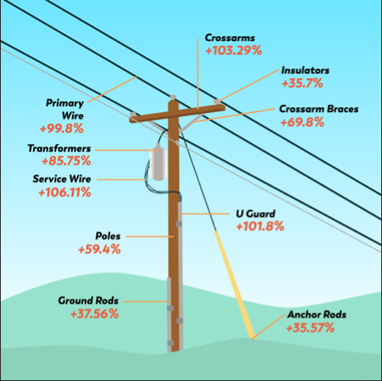
Rate Conversation
From the headlines:
“Our country is facing an unprecedented surge in demand for affordable electricity while confronting extreme weather threats to the reliability of our grid and trying to stay one step ahead of the massive technological changes we are seeing in our society,” FERC Chairman Willie Phillips said. “Our nation needs a new foundation to get badly needed new transmission planned, paid for and built. With this new rule, that starts today.” - Federal Energy Regulatory Commission (FERC), May 13, 2024
We're in a changing landscape
Inflation is a key factor
More new members and rising demand for reliable electricity
Grid is changing – bringing on more intermittent resources, like renewables such as solar and wind
Everything must work collaboratively to remain stable and reliable

Slide 13
Rate Design and Delivering on our Vision
Rate Design – What makes EU different?
We consistently review our performance in comparison to our peers:
Safety – “Exceptional” Safety Culture that we survey annually and continue to challenge
Lowest Cost – EnergyUnited is positioned well, we are the top quartile among low-cost energy providers in NC
Reliability – 12 Month Rolling Average
Sustainability - We have a plan to grow from 1MW of solar to 25MW of solar by end of 2025
The membership owns a $767M asset (poles, lines, buildings, equipment, etc)
Investing in and maintaining this asset reduces risk, ensures resilience, and enables future growth
x
=

Slide 14
EnergyUnited is Committed to our Members

Slide 15
Energy Efficiency

Slide 16
Energy Vampires
A device or appliance with a constant 1-watt current uses about $1 of electricity per year.
With our growing number of household appliances, this can quickly add up to $100 - $200 per year in annual energy costs.

Slide 17
Energy Efficiency for Appliances
When it’s time to put leftovers in the refrigerator, make sure the food is covered and allow it to cool down first. That way, the fridge doesn’t have to work harder to cool warm food.
Only run full dishwasher loads and avoid using the "rinse hold" function on your machine for just a few dirty dishes; it uses 3-7 gallons of hot water each use.

Slide 18
Summer Energy Efficiency
Installing a smart thermostat is one of the simplest ways to manage home energy use and keep summer bills in check.
Sealing air leaks around your home is a simple, effective way to save energy and lower your bills.
Applying new (or replacing old) weather stripping around doors and windows can instantly make your home more comfortable and reduce energy waste.
Visit energyunited.com to find more energy efficiency tips and use the energy usage explorer tool in My EnergyHub to identify opportunities to save energy.

Slide 19
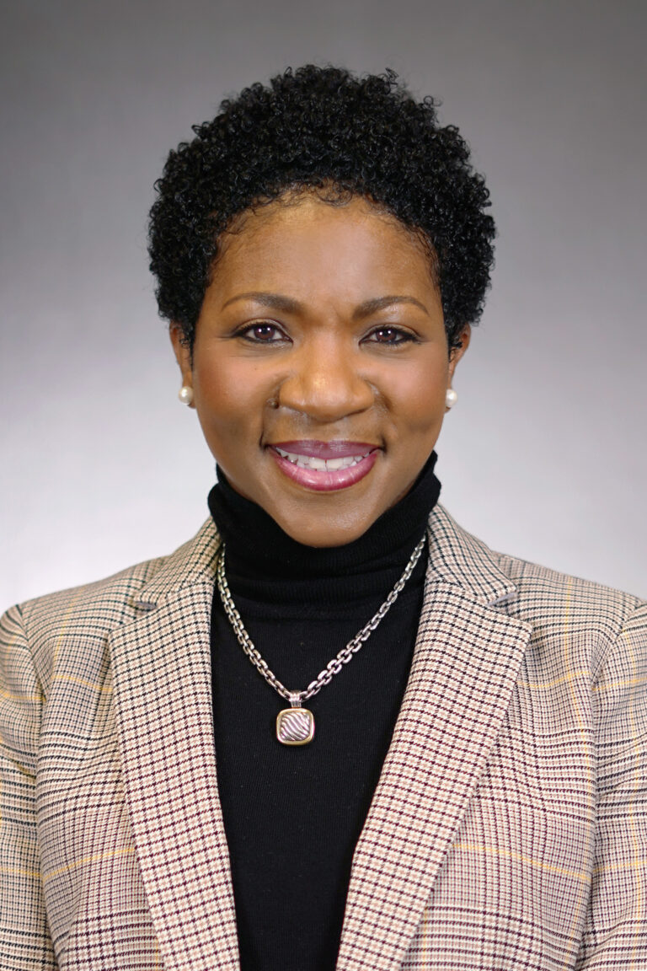
SCAMs
LaQuisha Parks
VP, Energy Services &
Corporate Communications

Slide 20
Malvertising Scam
Members receive malicious links and phone numbers when searching for 'Energy United' on some web browsers.
Mobile device users have reported this issue predominantly.
Intent is for individual to call phone number to steal money and personal information.

Slide 21
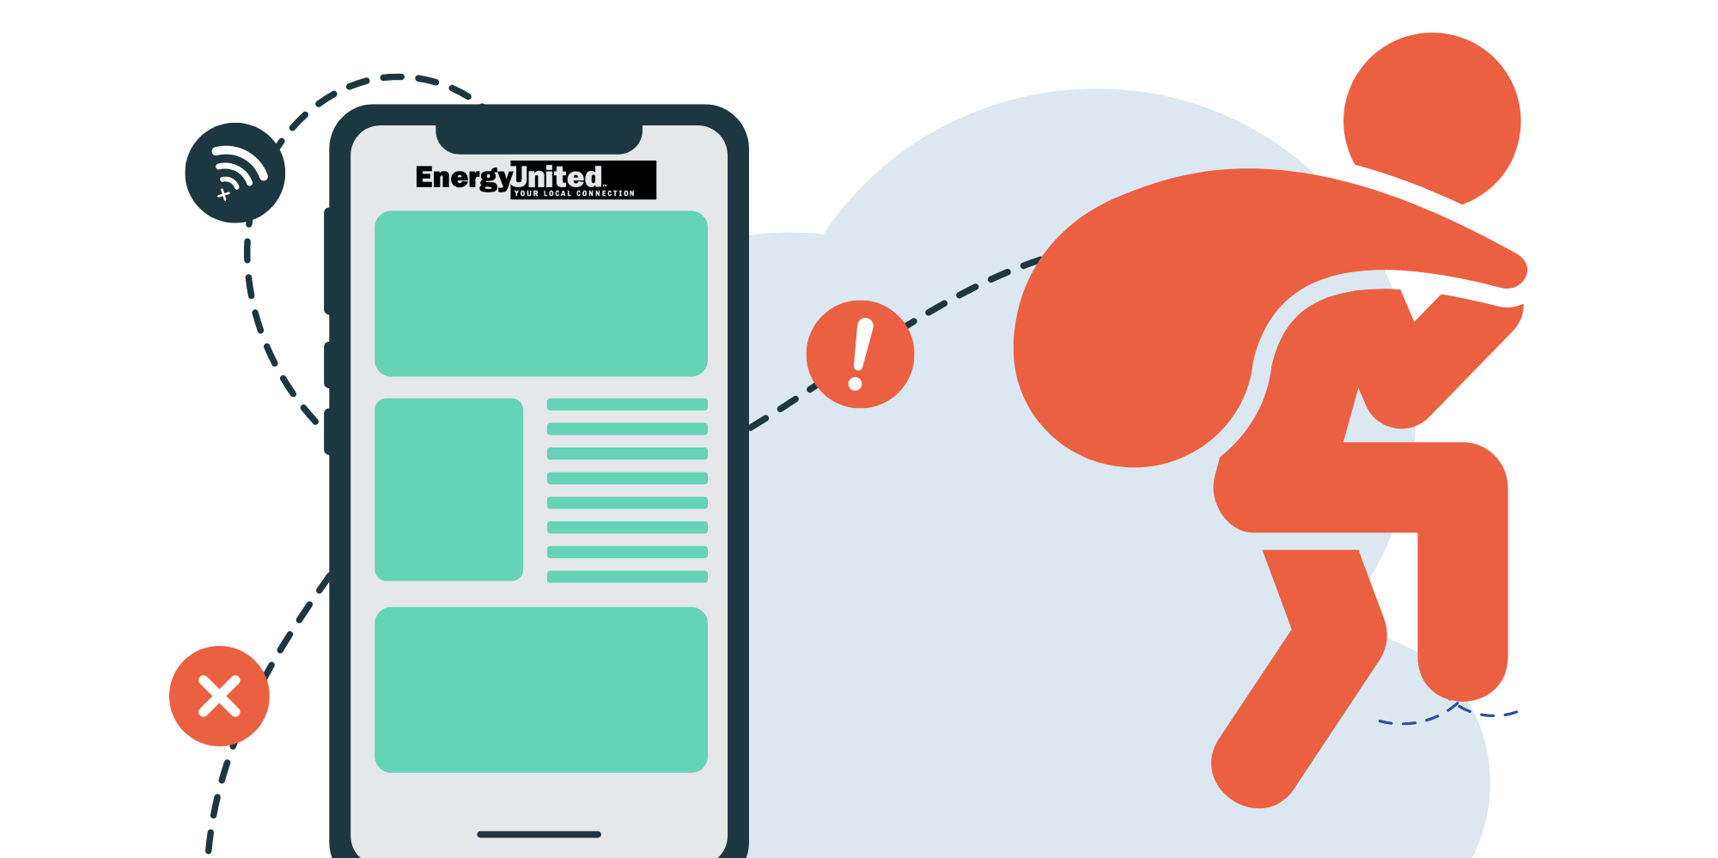
SCAM ALERT
EnergyUnited has received reports from a small number of members about two scams. We are also aware of similar reports involving other businesses.
Phone Calls: These scam phone calls are from individuals who claim to be employees of EnergyUnited. They have threatened disconnection unless an immediate payment is made.
EnergyUnited will never threaten immediate disconnection for nonpayment or demand immediate payment over the phone.
EnergyUnited will never provide a barcode via text message to pay your bill.
Web Search Results: Members searching for EnergyUnited contact information received malicious results with phone numbers that belong to scammers.
USE only EnergyUnited contact information on your bill or from our website when paying your bill.
EnergyUnited will never accept payment over the phone with a representative, we only accept call center payments through our automated phone system.

Slide 22
Comments

Slide 23
SAVE THE DATES
NEXT MAC MEETINGS
Statesville – October 3, 2024
Lexington – October 10, 2024
Lake Norman – October 24, 2024

